Slide 1
The Digital Divide: The Hardest Problems to Solve are Sometimes The Easiest to See
Dave Winter, CSULB
ENGR 350 -- Fall, 2019

Slide 2
Information, Knowledge and Judgment
Should we just trust expert information or ‘wisdom of the crowd’ judgment when we see it?
The web is filled with false information (medical treatment, historical reference, financial advice, political information…)
Search engines generally help us find content – but web sites are ranked by popularity, not by expert evaluation

Slide 3
One Example:
Wikipedia: (how does Wikipedia work?)
Written by volunteers, so some posts are biased or inaccurate
Anyone can contribute, but most choose not to
Those that do write are generally not educated in the field, but consider themselves experts, of some sort
References don’t always check out

Slide 4
What’s the problem with Communal Wisdom?
“Wisdom of the Crowd”
Problems with unreliable information are not new
The web seems to magnify those problems
SEO algorithms don’t take truth into consideration
Site operators are responsible for evaluating information submitted on their sites
But this costs time and money, and seems to be becoming less important… (generally, our society has held that the more information we have online, the better – regardless of the quality of that information)

Slide 5
Vulnerable Viewers
Who is a vulnerable viewer online?
Children – should be protected from certain content
Old People – the targets of many scam attempts
Less educated individuals – we’re not speaking to overall education level, but knowledge about a specific topic
Anyone who will misinterpret information at least one time (so, in some sense, everyone on the planet)

Slide 6
Computers and Community
The WWW brings folks together from everywhere
Email and the WWW provide quick and cheap ways to stay in contact
Social networking now allows deep insight into personal lives
Our communities have become somewhat globalized

Slide 7
So… what does all this mean?
It means the world is getting smaller…
And when that happens, we must face
The Digital Divide.

Slide 8
The Digital Divide
Used to refer to the separation of those who had access to technology and didn’t
Now, it speaks to the gap between those who have access to technology and the knowledge of how to interpret information and those who don’t
“Access” and “Knowledge” speak to:
The know-how to use any technology
The ability (physical or otherwise) to use that technology
A basic understanding of how to protect oneself online
An ability to identify content that is not trustworthy

Slide 9
The Digital Divide…
There’s an important distinction to make here:
Well, there seems to be a “Lamborghini Divide” in the US – I don’t have one, and others do
This divide really isn’t the same as The Digital Divide
Owning a nice car doesn’t give someone an advantage over others in the same way that access to the WWW does (there are services that replace cars)
The WWW gives us access to education, access to make informed decisions, access to communication, or to oversee our information, finances, job hunt…
If we didn’t have access to the internet, what service would replace those things?

Slide 10
Image Manipulation and The Digital Divide
We can easily see an influence on the Digital Divide when we look closely at images that have been falsely manipulated
Regarding the Manipulation of images:
Movies and videos use incredible special effects to add creativity and enjoyment to entertainment
But, people can also use this technology for deception and fraud
This sometimes happens even when deception isn’t even the goal
Sometimes, the difference between entertainment and deception isn’t immediately clear

Slide 11
Image Manipulation
Let’s take a look at some examples of manipulated images that has resulted in some influence over The Digital Divide
(these often appear on “top 20” lists of most deceiving manipulated images)

Slide 12
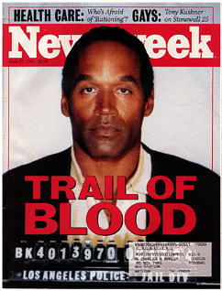
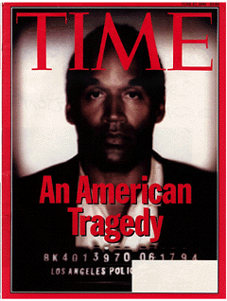

Slide 13
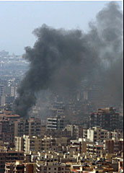
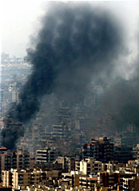

Slide 14



Slide 15
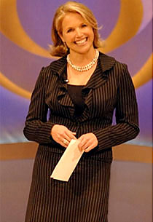
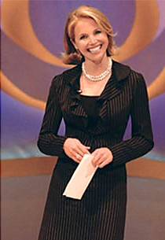

Slide 16
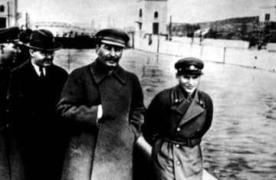
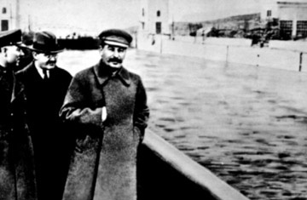

Slide 17
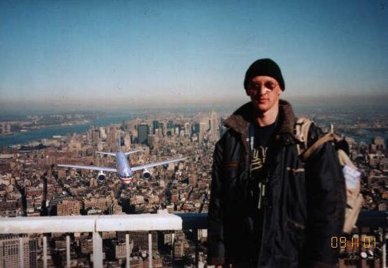

Slide 20
Image Manipulation can even change our public perception of the world
Dove commercial of a model being prepped for a billboard advertisement
http://www.youtube.com/watch?v=qhib8XiDc9Y&feature=related

Slide 21
Billions?
The Digital Divide and the next billion users:
Approx. 4.2 billion people worldwide have access to the WWW
That means 3.4 billion still don’t
And, only about 2 billion of us are really “active” users
About half the world can get online – up from just 6% in 2000
Discussions about the Digital Divide have generally focused on things like income, education, location and other stereotypical demographics… but its not just about that
Its really about knowing how to protect/educate yourself and others online

Slide 22
http://www.internetworldstats.com/stats.htm

Slide 23
With Great Power Comes Great Responsibility
What happens when we see such a great influx of users?
We get more vulnerable viewers
Immediately, we see users being encouraged to post their info online
We see that users often misinterpret or misunderstand new information, leading to social and societal problems
We see that users don’t often understand the multi-part nature of privacy issues and aren’t knowledgable about Sociological research or the dangers of online activity

